Slide 1
Program Name

Slide 2
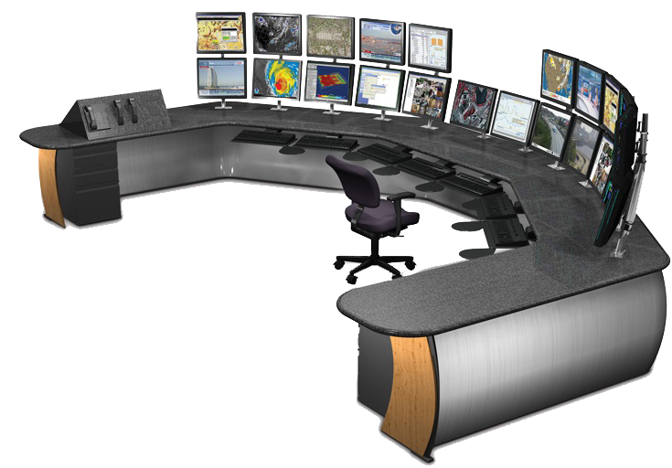
Modifies Prices
Controls Distributor Center
Control Center
Controls Items sold at the Retail Store

Slide 3
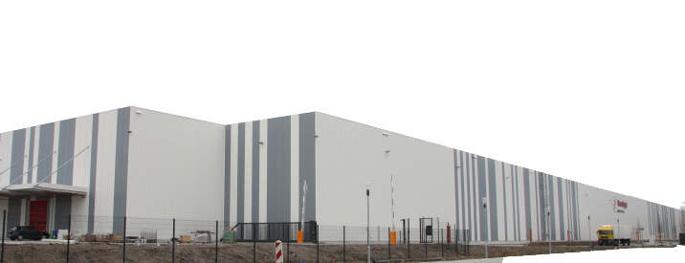
Updates Stock
Adjusts Prices from Control Center
Distributor Storage
Center
Updates Item Details

Slide 4
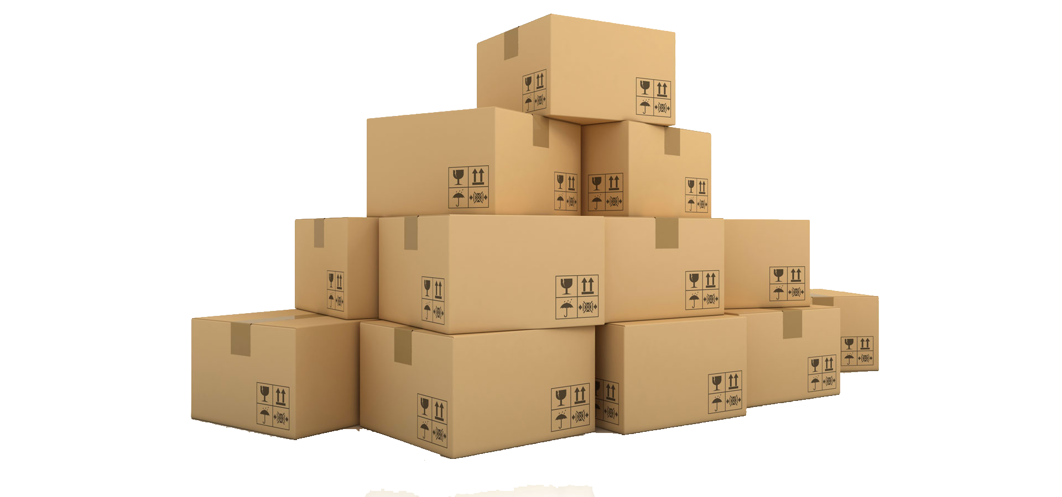
Ships Package
Updates Status
Shipping Center
Receives Inventory Stock

Slide 5
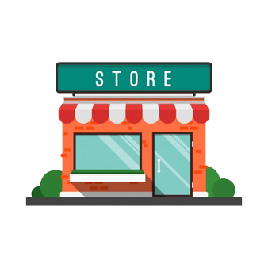
Receives Pricing from Control Center
Updates Stock from Shipping Center
Retail Store
Request’s Restock from Distributor

